Slide 1
Welcome To Our Project

Slide 2
Project Name
All About Fitness
Group - 01
Name | ID
Md. Shakur Zaman | 1531378642
Sadman Shapnil | 1712309642
Rifat Reza Ratul | 1821005042
Akhinur Akter Somaya | 1831104042

Slide 3
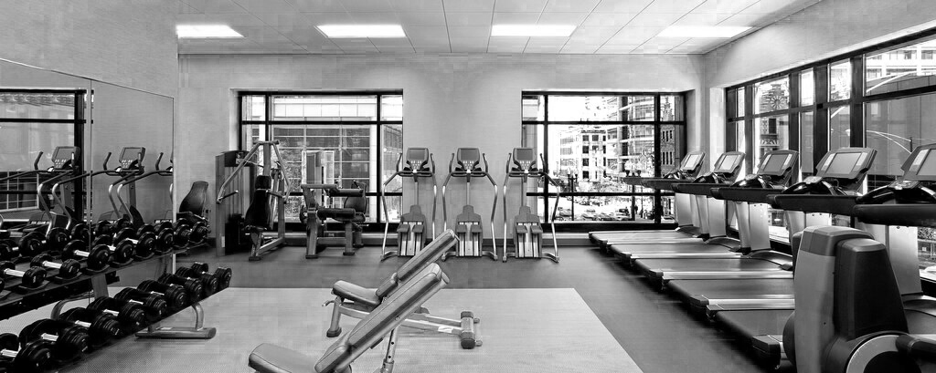
Introduction Our project is basically for them who run the fitness center. Those who will operate the software, they will be able to add or update the information of all the members of their center and calculate their income and expenditure etc. and sell exercise equipment through this one software. On the other hand, users can buy exercise equipment at home and users can become a member of that organization by purchasing a membership package and as a result they will get some special benefits.

Slide 4

What is the goal?
Our goal is to bring people under a particular application.
Also provide them a new system. By which they can enjoy more benefits in one application and by which the seller and the consumer could get all benefits.
And to make this project acceptable to more people in the future.
Also Women and Children's can get benefit from this.

Slide 5
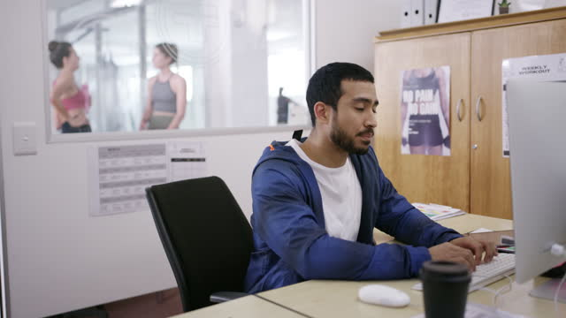
Our Target Customers: Basically, our target customers are those who run the fitness center. There are many people who have created a separate website application for buying and selling products and have created a separate application for their fitness center management system.

Slide 6
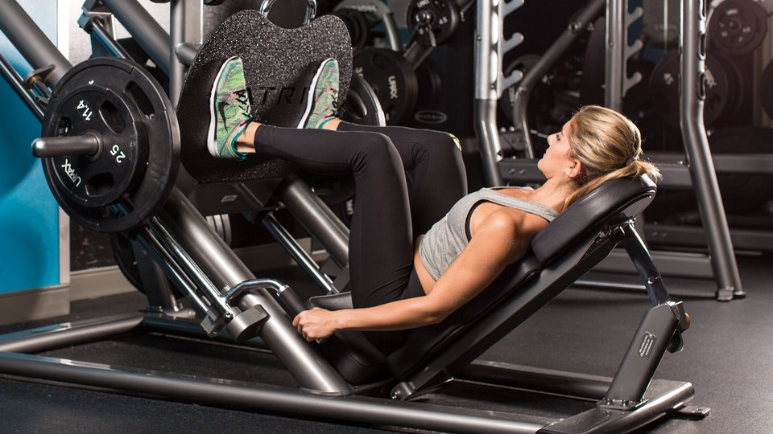
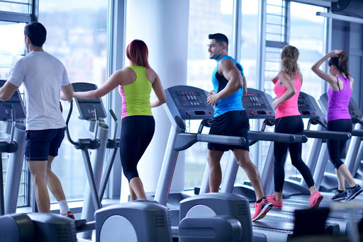
Our Target Audience Our main audience are health conscious men , women and children of all ages who like to change their lifestyle . Just as they can buy products at home, so they can also subscribe membership at home.

Slide 7

Why we need this Application ?
As the pandemic causes more restrictions, this system will enable members to book and schedule their own time slots through online.
This will eventually decline the risk of being infected. This system will arrange a benefits to both parties. Besides, customers will able to buy fitness equipment’s and certain products through online.
However, the gym members will get special discounts on the same equipment’s and products. Moreover, certain facilities like personal trainer, Buy Membership Online, Discount offer etc. will be available for the members only.
On the other hand, those who run a fitness center used to need two different software’s. One is to manage their gym data and the other is if they were selling any product. But now they can do these two things together through a software and at the same time can register for membership online at home.

Slide 8

Function & Specialty
For User –
Buy Equipment / Product
Buy Membership Package
Set Own Workout Planning
Assigning Trainer Personally
Update their full account
For Admin –
Can Manage full system
Add Members detail to his Database
Upload Products
Can send Notice
Manage Trainer

Slide 9

What was our process to start this project ?
We first research the sustainability of this management System.
Find out what other web sites on the market do not have.
Then we come up with some new features and highlight them through various diagrams.
We design the user interface to make the web site look what it looks like or add something to make the site look perfect.

Slide 10
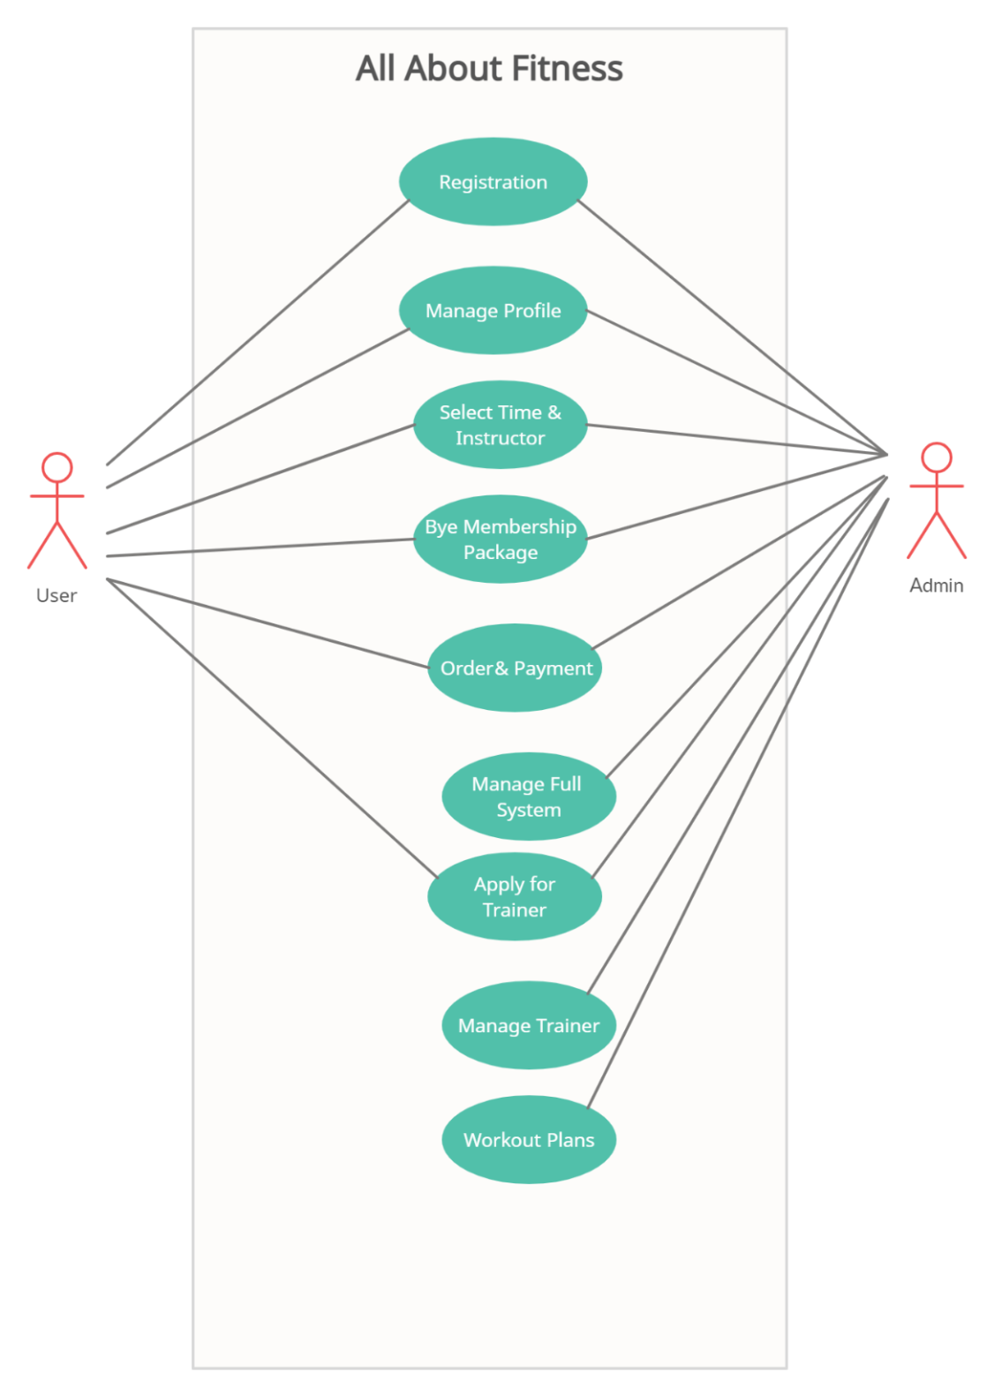
UML :

Slide 11
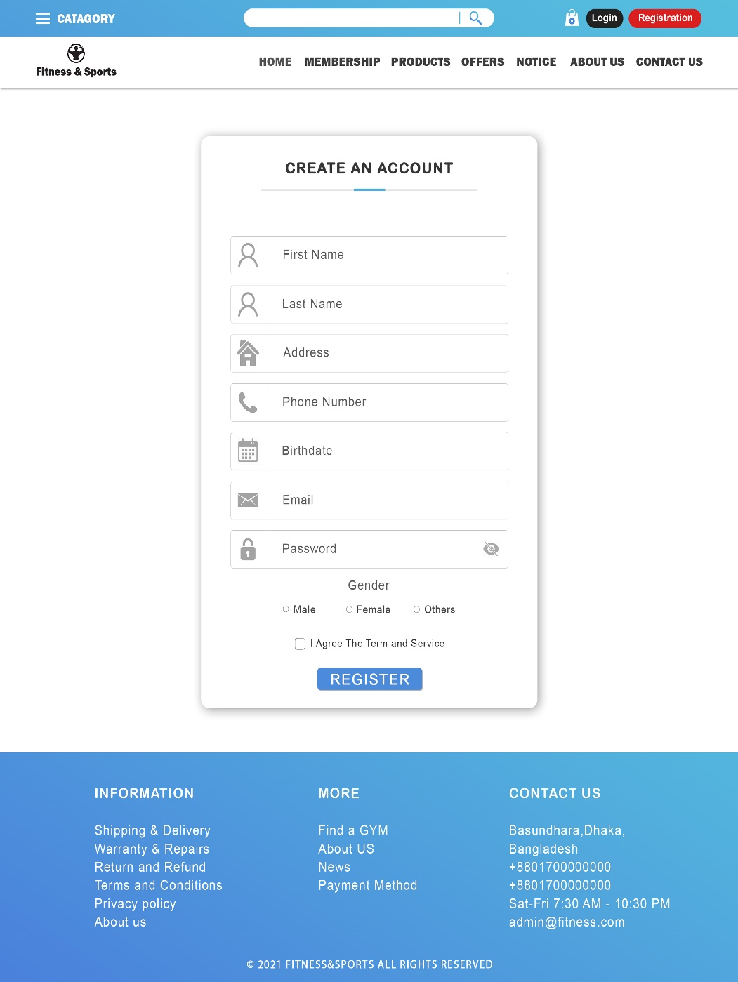
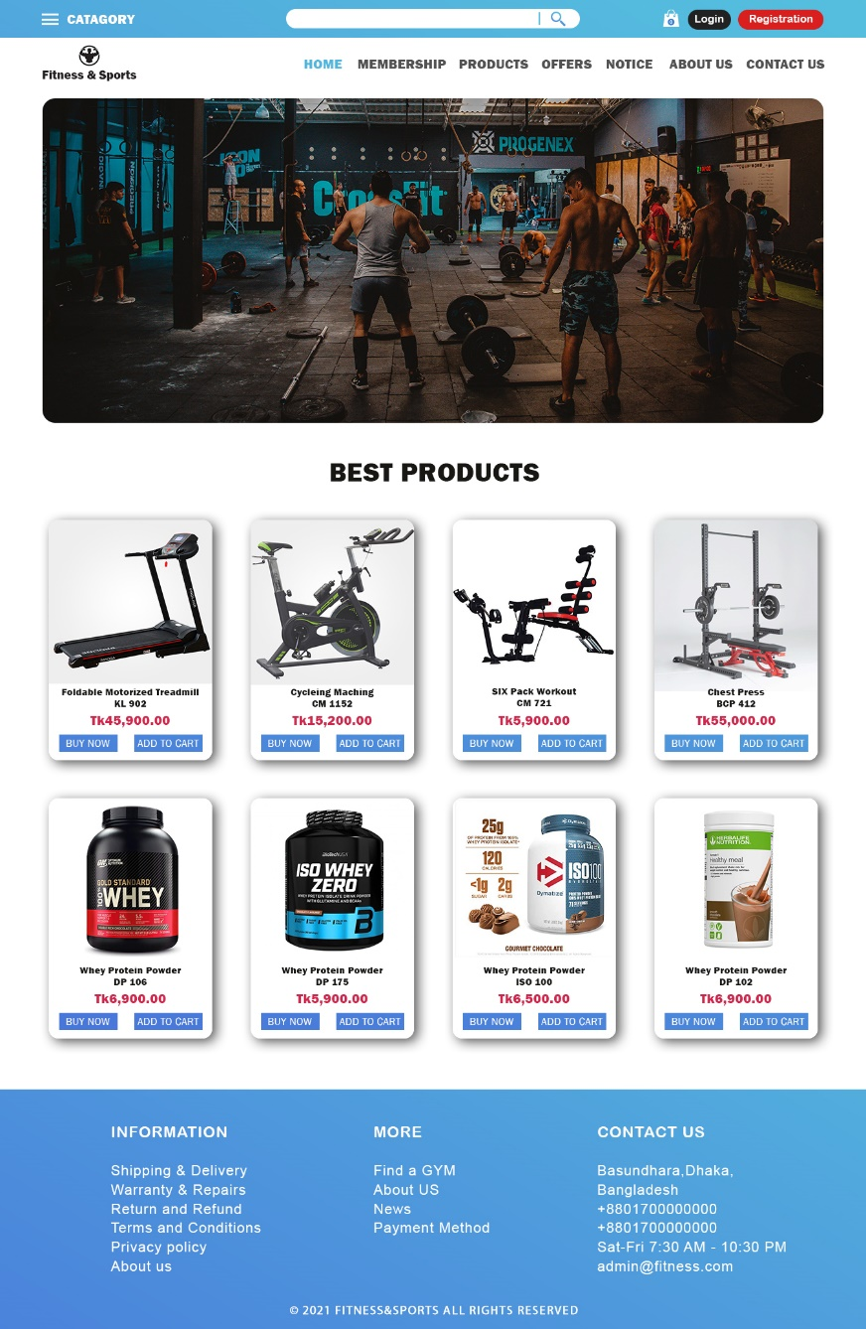
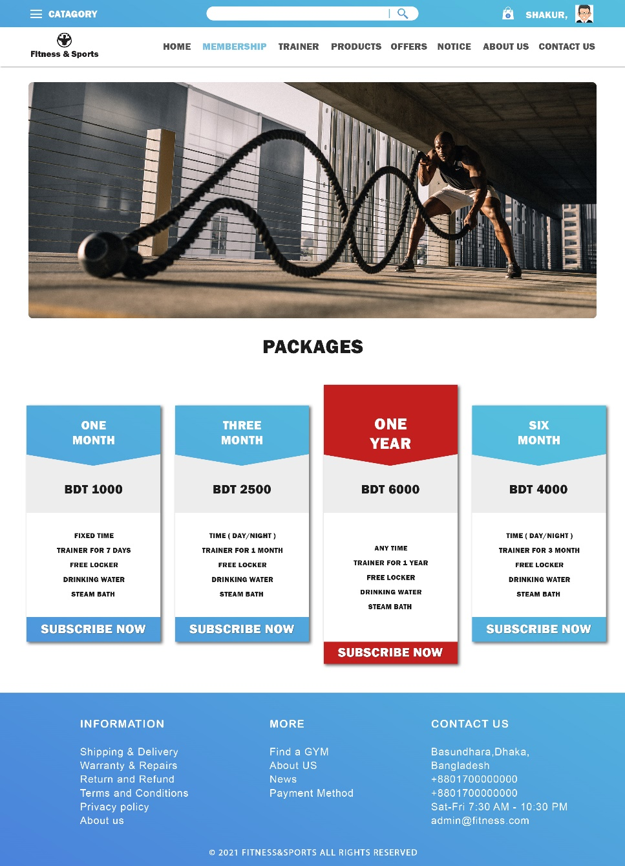
User Interface Design

Slide 12
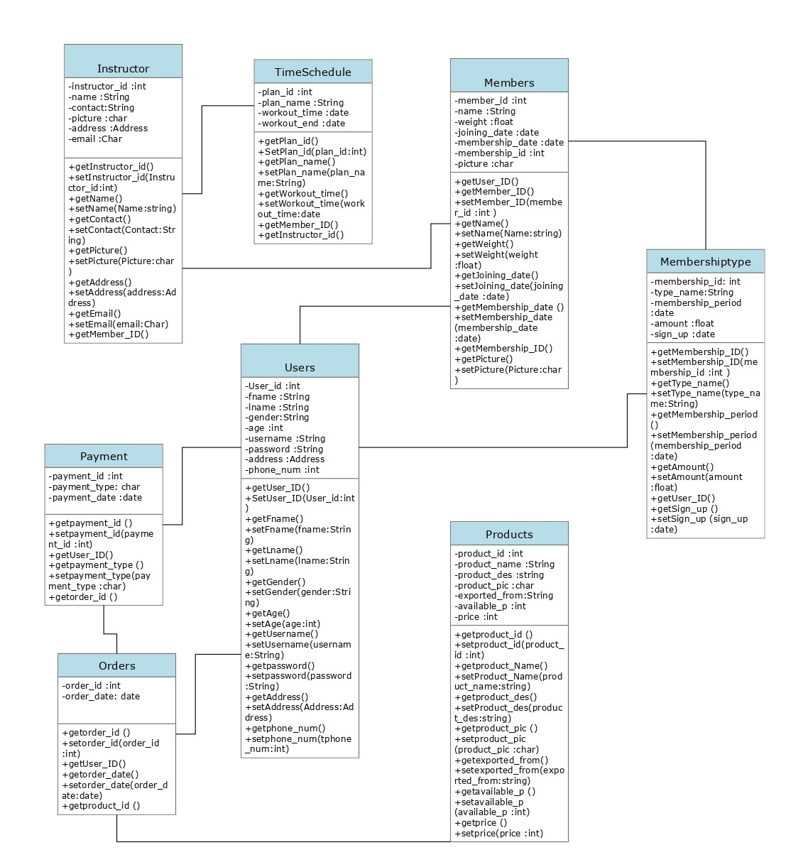
Class Diagram :

Slide 13
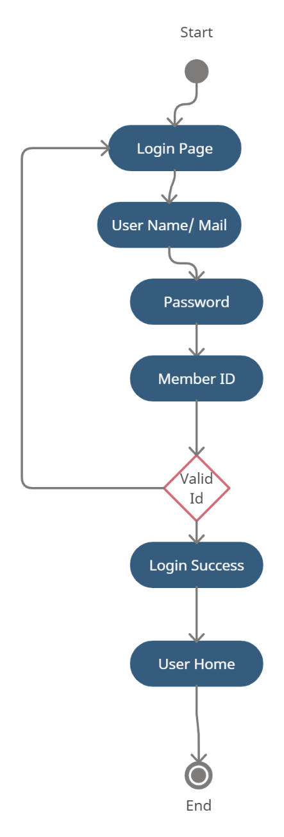
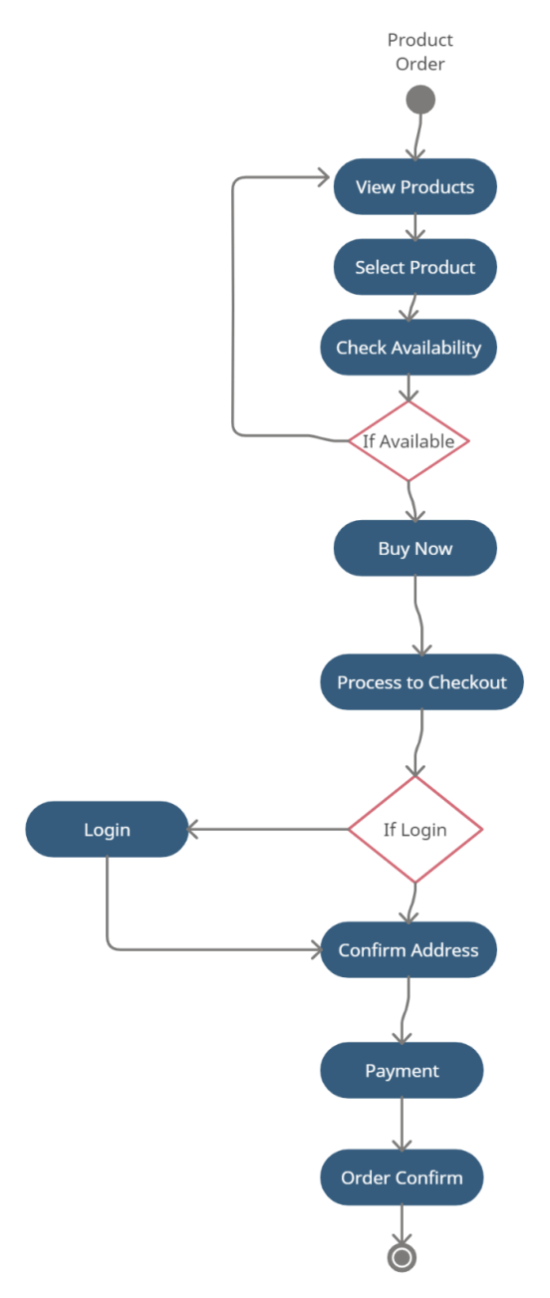
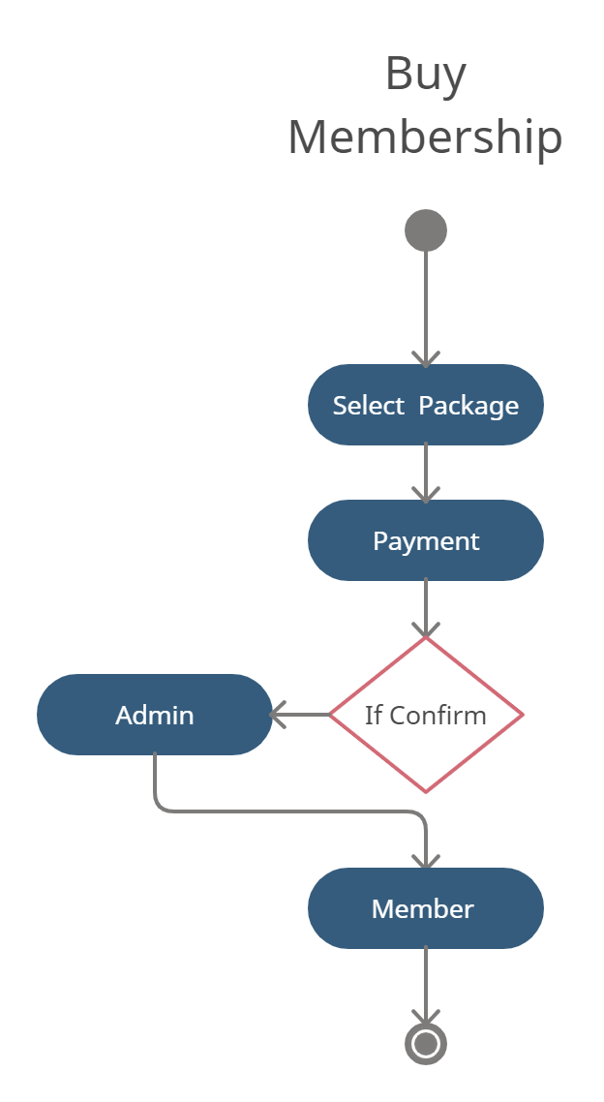
Activity Diagram :

Slide 14
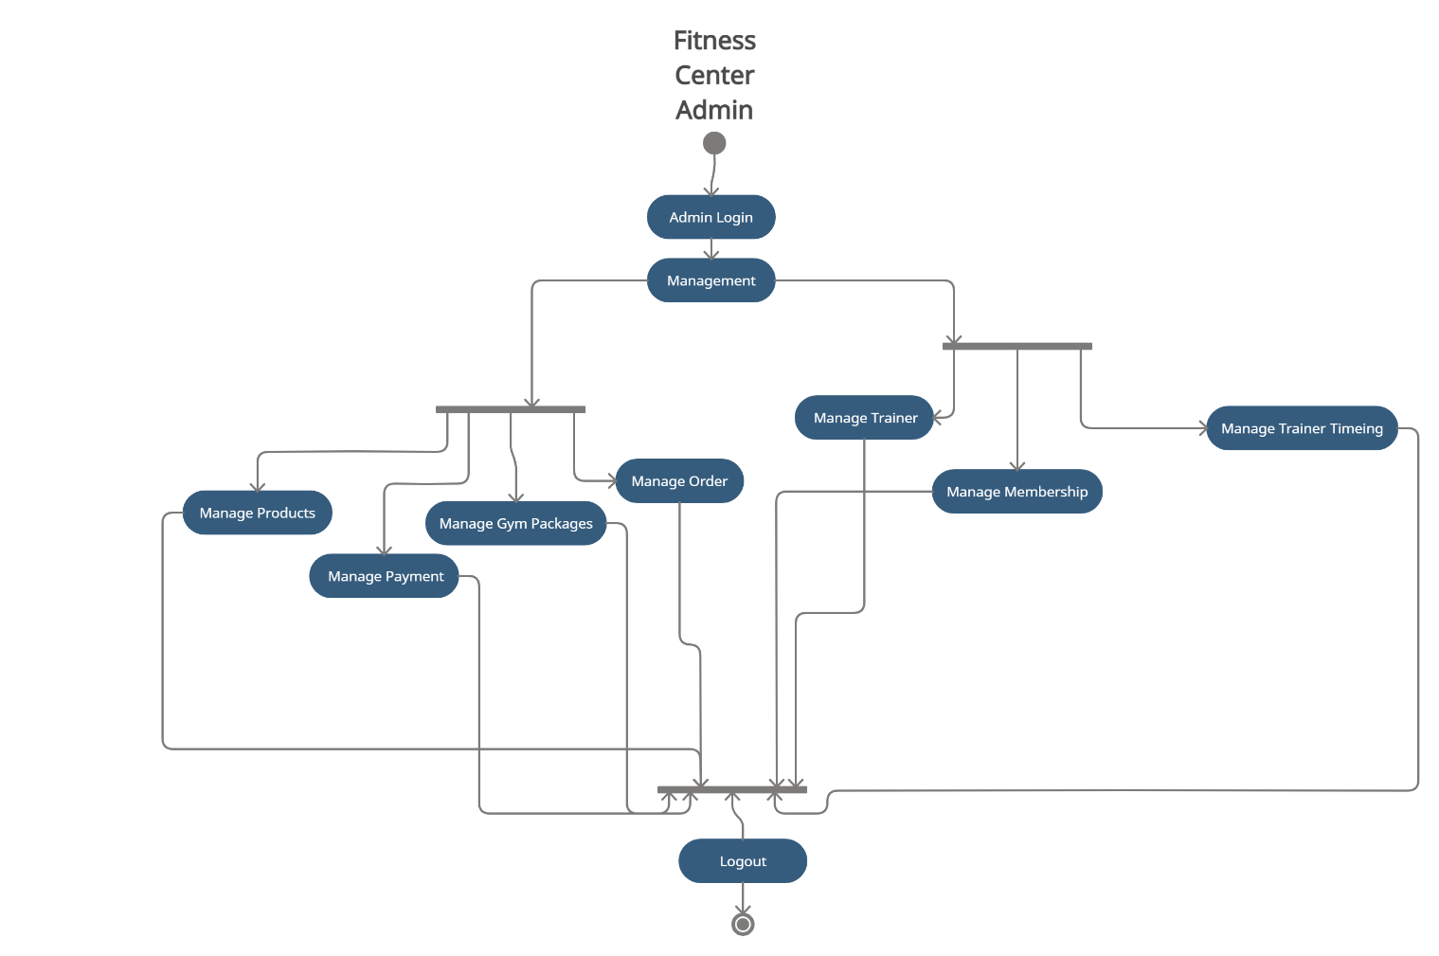

Slide 15
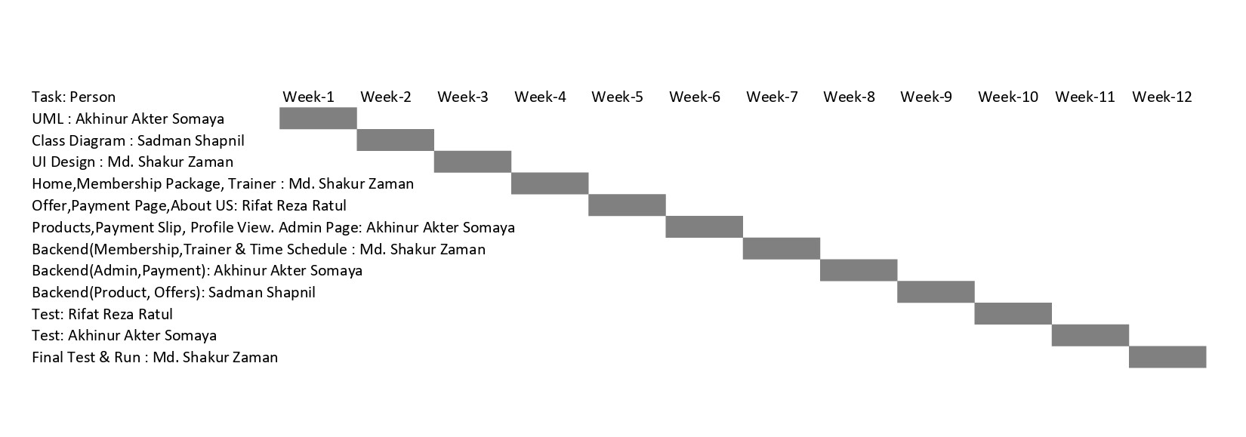
Timeline Chart

Slide 16
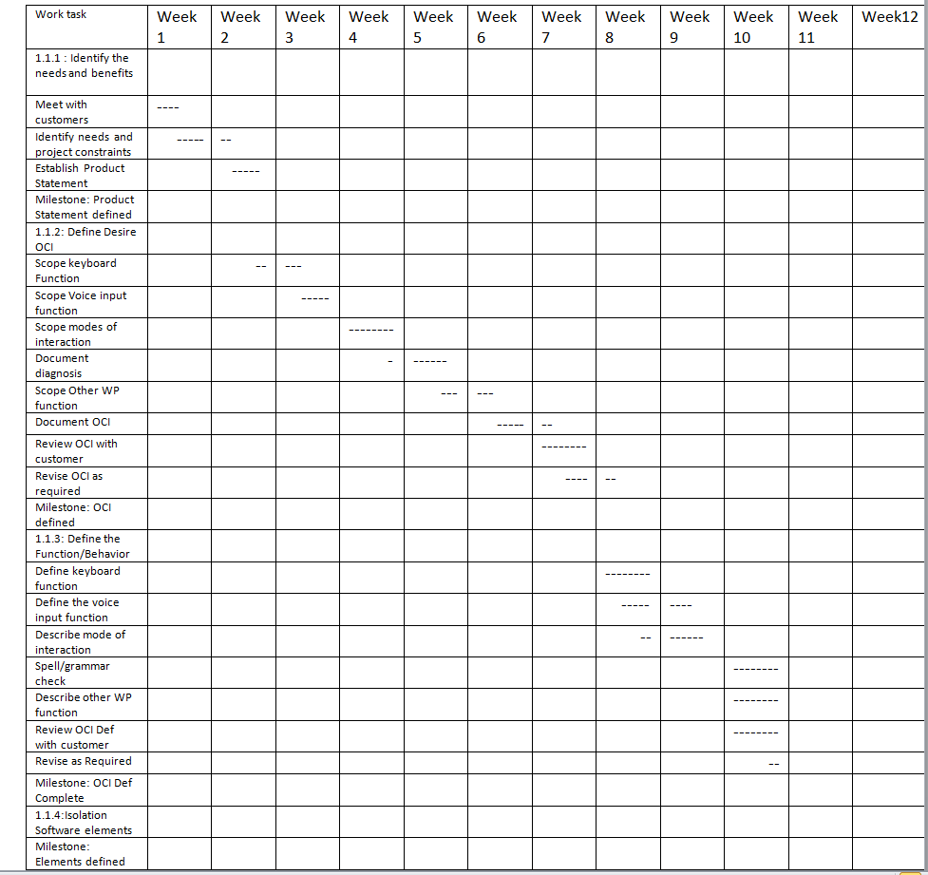
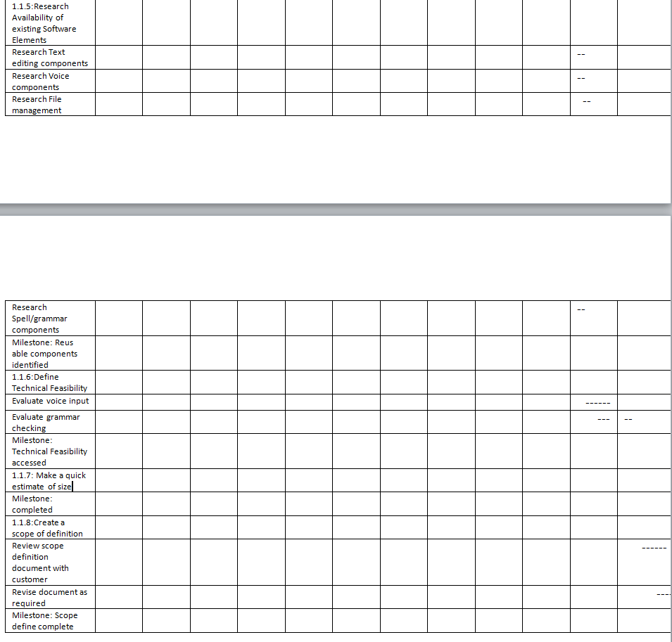
Week 11 Week 12

Slide 17
Budgeting

Slide 18
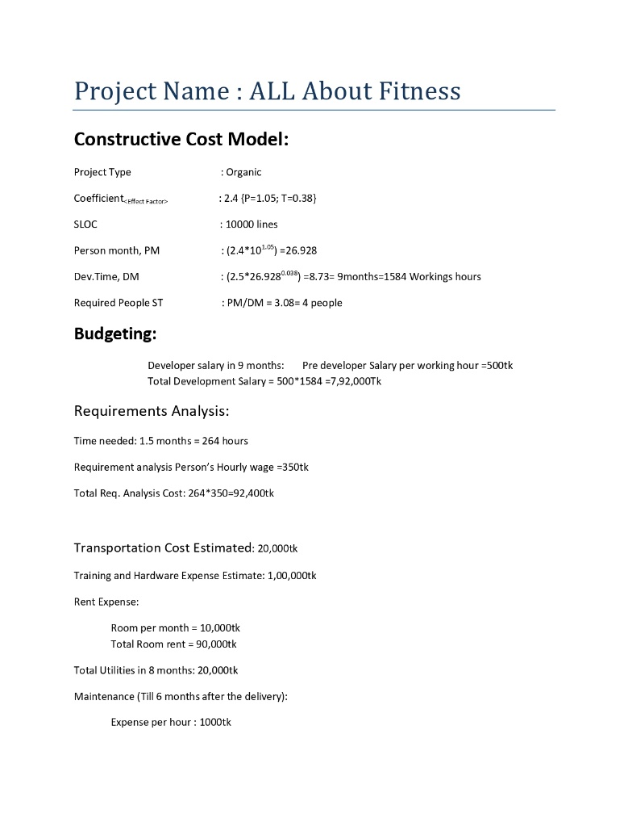
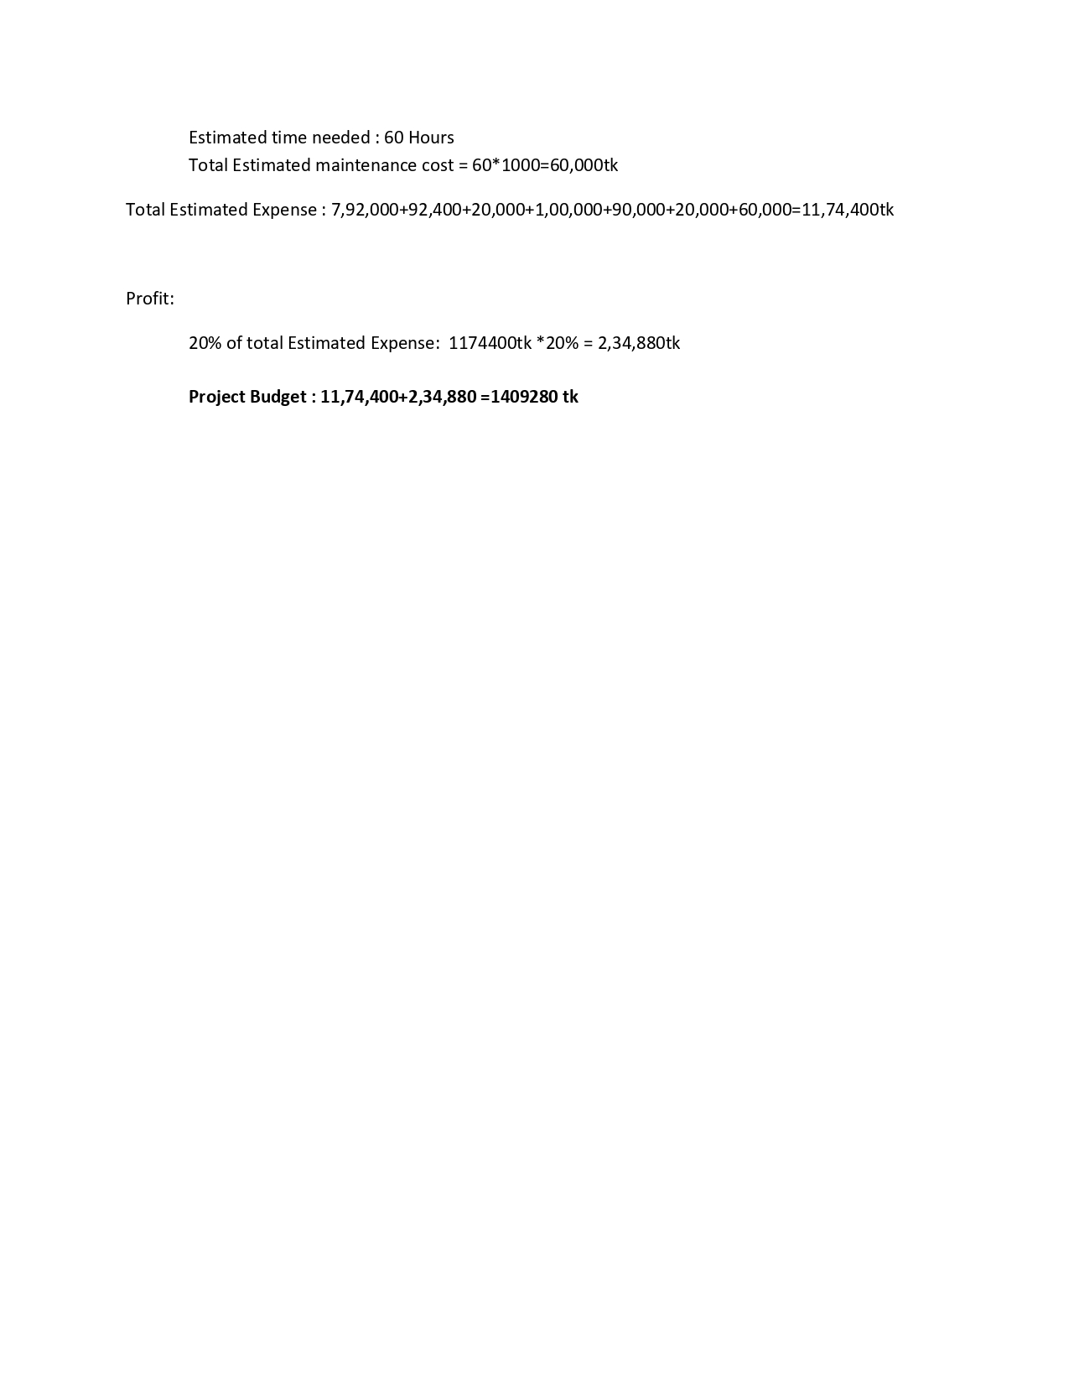

Slide 19
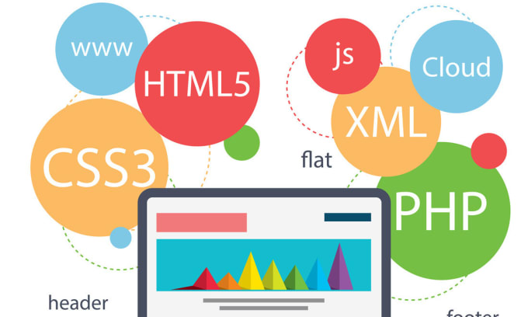
Software
We will use Visual Studio Code, Xampp
Frontend: HTML, CSS,
Backend: JavaScript , PHP and MySQL

Slide 20

Conclusion
We hope that this app will be able to successfully meet the needs of customers and vendors more than all the other applications currently on the market and everyone will be able to avail their services under a single application. As a result, those who used to create two separate applications at a higher cost will now be able to perform multiple tasks in one.

